Slide 1
Lesson 14
Working with Packages

Slide 2

Objectives
After completing this lesson, you should be able to:
  Overload package procedures and functions
  Use forward declarations
  Create an initialization block in a package body
  Manage persistent package data states for the life of a session

Slide 3

Lesson Agenda
  Overloading package subprograms
  Initializing packages
  Managing persistent package state in a session

Slide 4






Why Overloading of Subprogram?
Hey Alice, Can you help me with this task at hand. I want to calculate the tax of all employees in the company ….
……Wait not all employees, but only employees of a single department
……or may be a single employee …. Or I think I need all of those options. Can you help… ?
Happy to help ☺

Slide 5
Overloading Subprograms in PL/SQL
  Enables you to create two or more subprograms with the same name
  Requires that the subprogram’s formal parameters differ in number, order, or data type family
  Enables you to build flexible ways for invoking subprograms with different data
  Provides a way to extend functionality without loss of existing code; that is, adding new parameters to existing subprograms
  Provides a way to overload local subprograms, package subprograms, and type methods, but not stand-alone subprograms

Slide 6

Overloading Procedures Example:
Creating the Package Specification
CREATE OR REPLACE PACKAGE dept_pkg IS
PROCEDURE add_department
(p_deptno departments.department_id%TYPE,
p_name departments.department_name%TYPE :='unknown',
p_loc departments.location_id%TYPE := 1700);
PROCEDURE add_department
(p_name departments.department_name%TYPE :='unknown',
p_loc departments.location_id%TYPE := 1700);
END dept_pkg;
/

Slide 7

Overloading Procedures Example:
Creating the Package Body
-- Package body of package defined on previous slide.
CREATE OR REPLACE PACKAGE BODY dept_pkg IS
PROCEDURE add_department –- First procedure's definition
(p_deptno departments.department_id%TYPE,
p_name departments.department_name%TYPE := 'unknown',
p_loc departments.location_id%TYPE := 1700) IS
BEGIN
INSERT INTO departments(department_id,
department_name, location_id)
VALUES (p_deptno, p_name, p_loc);
END add_department;
PROCEDURE add_department –- Second procedure's definition
(p_name departments.department_name%TYPE := 'unknown',
p_loc departments.location_id%TYPE := 1700) IS
BEGIN
INSERT INTO departments (department_id,
department_name, location_id)
VALUES (departments_seq.NEXTVAL, p_name, p_loc);
END add_department;
END dept_pkg; /

Slide 8
Restrictions on Overloading
  You cannot overload:
    Stand-alone subprograms
    Subprograms whose parameters differ only in the mode (IN, OUT)
    Subprograms whose parameters belong to the same family respectively
    Functions which return only in the return type but not the formal parameters

Slide 9
STANDARD package
  Is an Oracle-supplied package
  Defines the PL/SQL environment
  Declares types, exceptions, and subprograms, which are available automatically to every PL/SQL program

Slide 10

Overloading and the STANDARD Package
  Most built-in functions in the STANDARD package are overloaded.
  An example is the TO_CHAR function:
FUNCTION TO_CHAR (p1 DATE) RETURN VARCHAR2;
FUNCTION TO_CHAR (p2 NUMBER) RETURN VARCHAR2;
FUNCTION TO_CHAR (p1 DATE, P2 VARCHAR2) RETURN VARCHAR2;
FUNCTION TO_CHAR (p1 NUMBER, P2 VARCHAR2) RETURN VARCHAR2;
. . .
A PL/SQL subprogram with the same name as a built-in subprogram overrides the standard declaration in the local context, unless qualified by the package name

Slide 11
Lesson Agenda
  Overloading package subprograms
  Initializing packages
  Managing persistent package state in a session

Slide 12
Package Instantiation and Initialization
  Packages are stored as schema objects.
  Packages are instantiated when referenced.
  Each application which references the package has its own instance.
  The package is initialized whenever instantiated .

Slide 13

Initializing Packages in Package Body
In package body, you can initialize package members in the initialization block at the end of the package body.
CREATE OR REPLACE PACKAGE taxes IS
v_tax NUMBER;
... -- declare all public procedures/functions
END taxes;
/
CREATE OR REPLACE PACKAGE BODY taxes IS
... -- declare all private variables
... -- define public/private procedures/functions
BEGIN
SELECT rate_value INTO v_tax
FROM tax_rates
WHERE rate_name = 'TAX';
END taxes;
/

Slide 14
Using User-Defined Package Functions in SQL
  Functions in user-defined packages can be accessed like those in Oracle-supplied packages.
  The user-defined package function usage is similar to that of functions such as MAX, MIN and other predefined functions.
  The package specification and body should be compiled before using them in the SQL statements in the current schema.
  You have to identify the functions with the package name.

Slide 15

User-Defined Package Function in SQL: Example
CREATE OR REPLACE PACKAGE taxes_pkg IS
FUNCTION tax (p_value IN NUMBER) RETURN NUMBER;
END taxes_pkg;
/
CREATE OR REPLACE PACKAGE BODY taxes_pkg IS
FUNCTION tax (p_value IN NUMBER) RETURN NUMBER IS
v_rate NUMBER := 0.08;
BEGIN
RETURN (p_value * v_rate);
END tax;
END taxes_pkg;
/
SELECT taxes_pkg.tax(salary), salary, last_name
FROM employees;

Slide 16
Lesson Agenda
  Overloading package subprograms
  Initializing packages
  Managing persistent package state in a session

Slide 17
Package State
  Package State refers to the values of the variables, constants, and cursors which are part of the package.
  When a package is instantiated, its state is initialized.
  The state of the package may change during application execution.
  A package without any members that hold a value is a stateless package.

Slide 18

Serially Reusable Packages
  SERIALLY_REUSABLE packages let you design applications that manage memory better for scalability.
How does the memory management actually work in an Oracle database for packages?

Slide 19
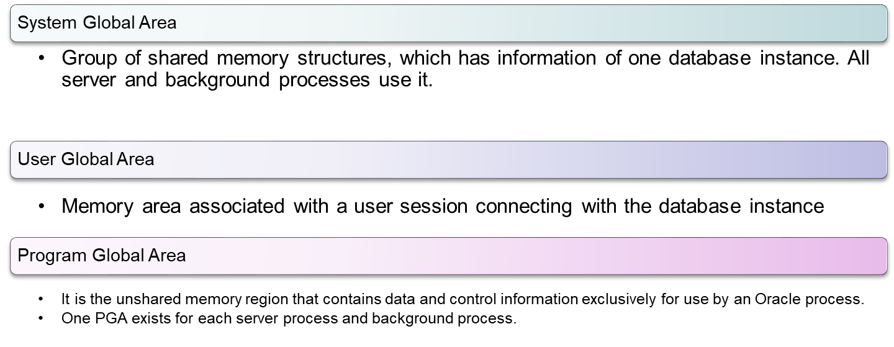
Memory Architecture
There are three important data structures defined according to the Memory Architecture of the database instance:

Slide 20
Serially Reusable Packages
  Package state of a package is stored in the user global area (UGA) for each user.
  Package state of a SERIALLY REUSABLE PACKAGE is stored in a work area in a small pool in the system global area (SGA).
  Storing the package state in the UGA limits the scalability of the application

Slide 21
Persistent State of Packages
The collection of package variables and the values define the package state. The package state is:
  Initialized when the package is first loaded
  Persistent (by default) for the life of the session:
    Stored in the User Global Area (UGA)
    Unique to each session
    Subject to change when package subprograms are called or public variables are modified
  Not persistent for the session but persistent for the life of a subprogram call when using PRAGMA SERIALLY_REUSABLE in the package specification
2
Value
Unique key column
Unique key column
Unique key column
Unique key column

Slide 22
State for Scott
Persistent State of Package Variables: Example
State for Jones
Time | Events | v_std_ comm [variable] | MAX (commission_pct) [column] | v_std_ comm [variable] | MAX (commission_pct) [Column]
9:00 | Scott> EXECUTE comm_pkg.reset_comm(0.25) | 0.10 0.25 | 0.4 | - | 0.4
9:30 | Jones> INSERT INTO employees(last_name, commission_pct) VALUES('Madonna', 0.8); | 0.25 | 0.4 |  | 0.8
9:35 | Jones> EXECUTE comm_pkg.reset_comm (0.5) | 0.25 | 0.4 | 0.10 0.5 | 0.8
10:00 | Scott> EXECUTE comm_pkg.reset_comm(0.6) Err –20210 'Bad Commission' | 0.25 | 0.4 | 0.5 | 0.8
11:00 11:01 12:00 | Jones> ROLLBACK; EXIT ... EXEC comm_pkg.reset_comm(0.2) | 0.25 0.25 0.25 | 0.4 0.4 0.4 | 0.5 - 0.2 | 0.4 0.4 0.4

Slide 23

Persistent State of a Package Cursor: Example
CREATE OR REPLACE PACKAGE curs_pkg IS –- Package spec
PROCEDURE open;
FUNCTION next(p_n NUMBER := 1) RETURN BOOLEAN;
PROCEDURE close;
END curs_pkg;
CREATE OR REPLACE PACKAGE BODY curs_pkg IS
–- Package body
CURSOR cur_c IS
SELECT employee_id FROM employees;
PROCEDURE open IS
BEGIN
IF NOT cur_c%ISOPEN THEN
OPEN cur_c;
END IF;
END open;
. . . -- code continued on next slide

Slide 24

Persistent State of a Package Cursor: Example
. . .
FUNCTION next(p_n NUMBER := 1) RETURN BOOLEAN IS
v_emp_id employees.employee_id%TYPE;
BEGIN
FOR count IN 1 .. p_n LOOP
FETCH cur_c INTO v_emp_id;
EXIT WHEN cur_c%NOTFOUND;
DBMS_OUTPUT.PUT_LINE('Id: ' ||(v_emp_id));
END LOOP;
RETURN cur_c%FOUND;
END next;
PROCEDURE close IS
BEGIN
IF cur_c%ISOPEN THEN
CLOSE cur_c;
END IF;
END close;
END curs_pkg;

Slide 25
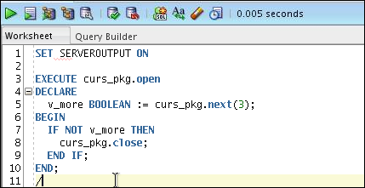
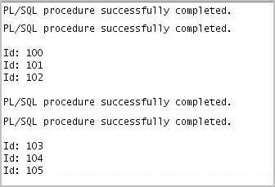
Executing the CURS_PKG Package

Slide 26

Quiz
Overloading subprograms in PL/SQL:
  Enables you to create two or more subprograms with the same name
  Requires that the subprogram’s formal parameters differ in number, order, or data type family
  Enables you to build flexible ways for invoking subprograms with different data
  Provides a way to extend functionality without loss of existing code; that is, adding new parameters to existing subprograms

Slide 27

Summary
In this lesson, you should have learned how to:
  Overload package procedures and functions
  Use forward declarations
  Create an initialization block in a package body
  Manage persistent package data states for the life of a session

